Slide 1

Noida Institute of Engineering and Technology, Greater Noida
Project Maintenance And Management Concepts
Unit: V
Software Engineering
ACSE0603
( B Tech 3rd Year)
Renu Devi
Assistant Professor
Department of CSE-AIML

Slide 2
Introduction of Faculty
Noida Institute of Engineering and Technology, Greater Noida
Name: Renu Devi
Qualification:
P.hD. (Pursuing)
M.Tech(Computer Science and Engineering)
B.Tech (Computer Science and Engineering)

Slide 3
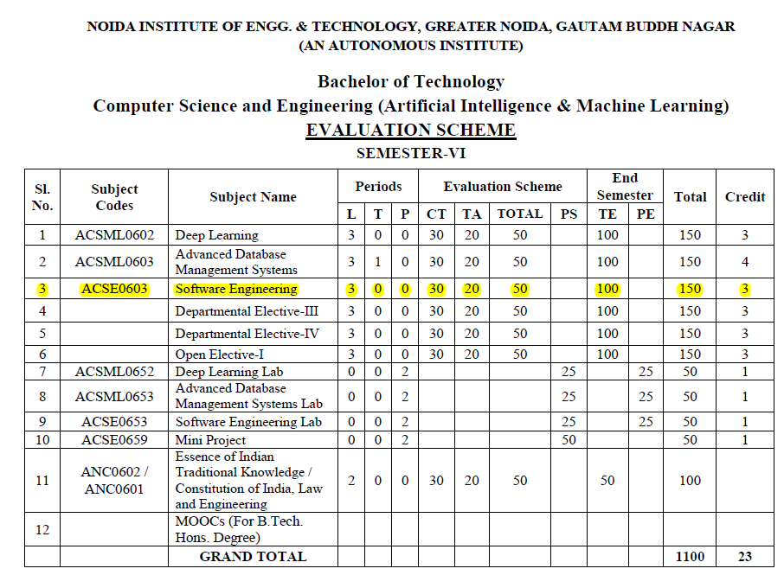
Evaluation Scheme

Slide 4
Syllabus
UNIT-I | Introduction | 8 Hours
Introduction: Evolving role of software, Software Characteristics, Software crisis, Silver bullet, Software myths, Software Engineering Phases, Team Software Process (TSP), emergence of software engineering, Software process, project and product, Software Process Models: Waterfall Model, Prototype Model, Spiral Model, Iterative Model, Incremental Model, Agile Methodology: Scrum Sprint, Scrum Team, Scrum Master, Product Owner.
UNIT-II | Software Requirement | 8 Hours
Software Requirement Specifications (SRS): Requirement Engineering Process: Elicitation, Analysis, Documentation, Review and Management of User Needs, Feasibility Study, Information Modelling, Use Case Diagram, Data Flow Diagrams, Entity Relationship Diagrams, Decision Tables, SRS Document, IEEE Standards for SRS. Software Quality Assurance (SQA): Quality concepts, SQA activities, Formal approaches to SQA; Statistical software quality assurance; CMM, The ISO standard.

Slide 5
Syllabus
UNIT-III | Software Design | 8 Hours
Software Design: Design principles, the design process; Design concepts: refinement, modularity: Cohesion, Coupling, Effective modular design: Functional independence, Design Heuristics for effective modularity, Software architecture: Function Oriented Design, Object Oriented Design: OOPs concepts-Abstraction, object, classification, inheritance, encapsulation, UML Diagrams-Class Diagram, Interaction diagram, Activity Diagram, control hierarchy: Top-Down and Bottom-Up Design, structural partitioning, software procedure.
UNIT-IV | Software Testing | 8 Hours
Software Testing: Testing Objectives, 7 Principals of Testing, Levels of Testing: Unit Testing, System Testing, Integration Testing, User Acceptance Testing, Regression Testing, Testing for Functionality and Testing for Performance, Top Down and Bottom-Up Testing Strategies: Test Drivers and Test Stubs, Structural Testing (White Box Testing), Functional Testing (Black Box Testing), Test Data Suit Preparation, Alpha and Beta Testing of Products. Functional Testing(DAO, BO) Static Testing Strategies: Formal Technical Reviews (Peer Reviews), Walk Through, Code Inspection, Compliance with Design and Coding Standards.

Slide 6
Syllabus
UNIT-V | Project Maintenance And Management Concepts | 8 Hours
Project management concepts, Planning the software project, Estimation: Software Measurement and Metrics, Various Size Oriented Measures-LOC based, FP based, Halestead’s Software Science, Cyclomatic Complexity Measures: Control Flow Graphs, Use-case based, empirical estimation COCOMO- A Heuristic estimation techniques, staffing level estimation, team structures, risk analysis and management. Configuration Management, Software reengineering: reverse engineering, restructuring: forward engineering, Clean Room software engineering. Case Tools, Software Maintenance: Preventive, Corrective and Perfective Maintenance, Cost of Maintenance, Need of Maintenance.

Slide 7
Branch wise Applications
Software engineering applications are new idea, device or process. Innovations are the application of better solutions that meet new requirements, in articulated needs or existing market needs.
The exhaustive and widespread use of computers and the improvements in database technology have provided large data.
The emerging growth of data in databases has generated an urgent need for efficient data mining techniques to discover useful informational knowledge.

Slide 8
Course Objective(unit 5)
The ability to engage in life-long maintenance and continuing Software development.
The ability to work in one or more significant application domains.

Slide 9
Course Outcomes
After completion of this course students will be able to
CO 1 | Identify, formulate, analyse, and solve problems, as well as identify the computing requirements appropriate to their solutions. The ability to work in one or more significant application domains | K2, K4, K5
CO 2 | Design, implement, and evaluate software-based systems, components, or programs of varying complexity that meet desired needs, satisfy realistic constraints, and demonstrate accepted design and development principles. | K2, K3, K4, K6
CO 3 | Apply knowledge of computing, mathematics, science, and engineering appropriate to the discipline, particularly in the modelling and design of software systems and in the analysis of trade-offs inherent in design decisions. | K3, K4
CO 4 | Formulate testing strategies for software system, apply various testing techniques such as unit testing, test driven development and functional testing. | K3
CO 5 | Understand ability to engage in life-long maintenance and continuing Software development using various software management tools. | K2, K5

Slide 10
Program Outcomes (PO)
PO1: Engineering Knowledge
PO2: Problem Analysis
PO3: Design/Development of solutions
PO4: Conduct Investigations of complex problems
PO5: Modern tool usage
PO6: The engineer and society
PO7: Environment and sustainability
PO8: Ethics
PO9: Individual and team work
PO10: Communication
PO11: Project management and finance
PO12: Life-long learning

Slide 11
COs-POs Mapping
CO-PO Correlation Matrices
Correlation levels are taken 1, 2 and 3 as defined below:
1: Slight (Low) 2: Moderate (Medium) 3: Substantial (High)
Sr. No | Course Outcome | PO1 | PO2 | PO3 | PO4 | PO5 | PO6 | PO7 | PO8 | PO9 | PO10 | PO11 | PO12
1 | ACSE0603.1 | 3 | 3 | 2 | 2 | 2 | - | - | - | - | - | - | 1
2 | ACSE0603.2 | 3 | 3 | 3 | 3 | 2 | - | - | 2 | 2 | 1 | - | 2
3 | ACSE0603.3 | 3 | 3 | 3 | 3 | 2 | - | 1 | 2 | 2 | 1 | 2 | 2
4 | ACSE0603.4 | 3 | 3 | 3 | 3 | 2 | 2 | 1 | 2 | 2 | 1 | 2 | 2
5 | ACSE0603.5 | 3 | 3 | 3 | 3 | 2 | 3 | 2 | - | 3 | 3 | 2 | 3
6 | Average | 3.0 0 | 3.00 | 2.80 | 2.80 | 2.00 | 1.00 | 0.80 | 1.20 | 1.80 | 1.20 | 1.20 | 2.00

Slide 12
Program Specific Outcomes (PSO)
PSO1: Work as a software developer, database administrator, tester or networking engineer for providing solutions to the real world and industrial problems
PSO2:Apply core subjects of information technology related to data structure and algorithm, software engineering, web technology, operating system, database and networking to solve complex IT problems.
PSO 3:Practice multi-disciplinary and modern computing techniques by lifelong learning to establish innovative career.
PSO 4:Work in a team or individual to manage projects with ethical concern to be a successful employee or employer in IT industry

Slide 13
COs-PSOs Mapping
Program Specific Outcomes and Course Outcomes Mapping
 | PSO1 | PSO2 | PSO3 | PSO4
ACSE0603.1 | 3 | 3 | 3 | 3
ACSE0603.2 | 3 | 3 | 3 | 3
ACSE0603.3 | 2 | 2 | 2 | 2
ACSE0603.4 | 3 | 3 | 3 | 3
ACSE0603.5 | 2 | 2 | 2 | 2
Average | 2.6 | 2.6 | 2.6 | 2.6
*3= High *2= Medium *1=Low

Slide 14
Program Educational Objectives
PEO1: To have an excellent scientific and engineering breadth so as to comprehend, analyze, design and provide sustainable solutions for real-life problems using state-of-the-art technologies.
PEO2:To have a successful career in industries, to pursue higher studies or to support entrepreneurial endeavors and to face global challenges.
PEO3:To have an effective communication skills, professional attitude, ethical values and a desire to learn specific knowledge in emerging trends, technologies for research, innovation and product development and contribution to society.
PEO4: To have life-long learning for up-skilling and re-skilling for successful professional career as engineer, scientist, entrepreneur and bureaucrat for betterment of society

Slide 15
Program Educational Objectives
Program Educational Objective and Course Outcomes Mapping
CO | PEO1 | PEO2 | PEO3 | PEO4
CO1 | 3 | 3 | - | 1
CO2 | 3 | 3 | - | 3
CO3 | 3 | 3 | - | 3
CO4 | 3 | - | - | -
CO5 | 3 | 3 | - | 3
*3= High *2= Medium *1=Low

Slide 16
Result Analysis
Subject Result: NA
Department Result: NA
Faculty-Wise Result: NA

Slide 17
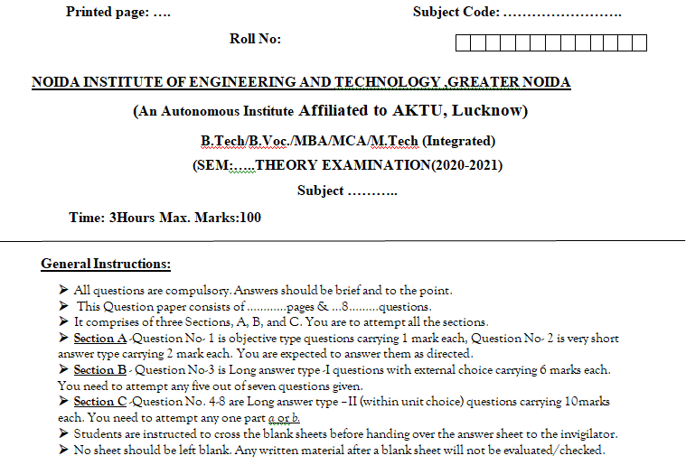
End Semester Question Paper Template

Slide 18
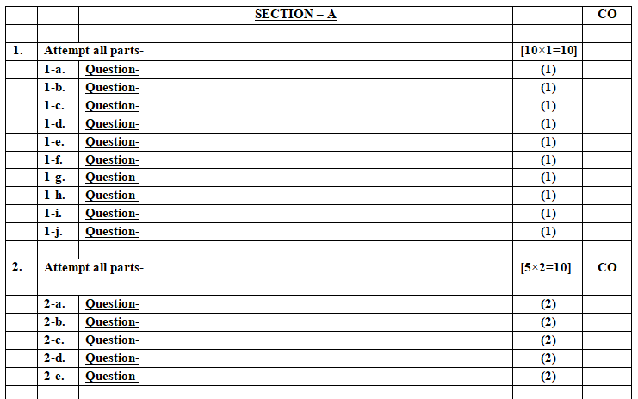
End Semester Question Paper Templates

Slide 19
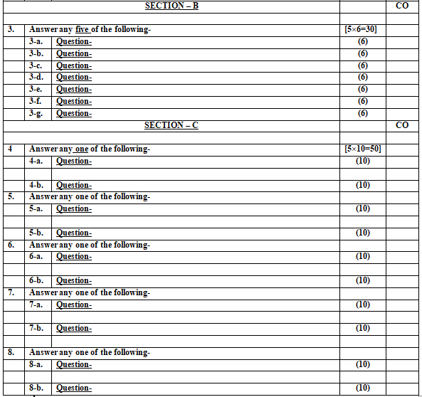
End Semester Question Paper Templates

Slide 20
Prerequisite
A Scripting Language
A Version Control Tool
Code Editors & IDEs (Integrated Development Environment)
Databases
Networking
Software Development Life Cycle (SDLC)

Slide 21
Recap
Basic Programming Skills
Innovative Thinking.
Enthusiasm to learn Management concepts.

Slide 22
Brief Introduction about the subject with videos
Software Engineering is a systematic, disciplined, quantifiable study and approach to the design, development, operation, and maintenance of a software system.
Objectives of Software Engineering:
Maintainability – It should be feasible for the software to evolve to meet changing requirements.
Efficiency – The software should not make wasteful use of computing devices such as memory, processor cycles, etc.
Correctness – A software product is correct if the different requirements as specified in the SRS document have been correctly implemented.
https://www.youtube.com/watch?v=kcvEiMFOcoE
https://www.youtube.com/watch?v=WxkP5KR_Emk

Slide 23
Unit Content
Project management concepts, Planning the software project
Estimation: Software Measurement and Metrics, Various Size Oriented Measures-LOC based, FP based, Halestead’s Software Science
Cyclomatic Complexity Measures: Control Flow Graphs, Use-case based, empirical estimation COCOMO- A Heuristic estimation techniques, staffing level estimation, team structures, risk analysis and management.
Configuration Management
Software reengineering: reverse engineering, restructuring: forward engineering, Clean Room software engineering.
Case Tools
Software Maintenance: Preventive, Corrective and Perfective Maintenance, Cost of Maintenance, Need of Maintenance.

Slide 24
Objective of Topics
TOPIC | Objective
Software Maintenance | To Understand the need of Software Maintenance
Software Project Management | Study of Software Project Management
Cost of Maintenance | To measure the Cost of Maintenance
Software Re- Engineering Reverse Engineering | To understand the Re- Engineering Reverse Engineering
Software Configuration Management | To study the Configuration Management
Estimation of cost and effort Parameters | To Find the cost and effort of the software

Slide 25
Project Management (CO5)
It is a proper way of planning and leading software projects.
It is a part of project management in which software projects are planned, implemented, monitored and controlled.
Need of Software Project Management:
Software is an non-physical product.
Most of the software products are made to fit client’s requirements.
The most important is that the basic technology changes and advances so frequently and rapidly that experience of one product may not be applied to the other one.
Such type of business and environmental constraints increase risk in software development hence it is essential to manage software projects efficiently.

Slide 26
Software Project Management consists of several different type of managements:
Conflict Management:
Conflict management is the process to restrict the negative features of conflict while increasing the positive features of conflict.
The goal of conflict management is to improve learning and group results including efficacy or performance in an organizational setting.
Properly managed conflict can enhance group results.
Risk Management:
Risk management is the analysis and identification of risks that is followed by synchronized and economical implementation of resources to minimize, operate and control the possibility or effect of unfortunate events or to maximize the realization of opportunities.
Requirement Management:
It is the process of analyzing, prioritizing, tracing and documenting on requirements and then supervising change and communicating to pertinent stakeholders.
It is a continuous process during a project.

Slide 27
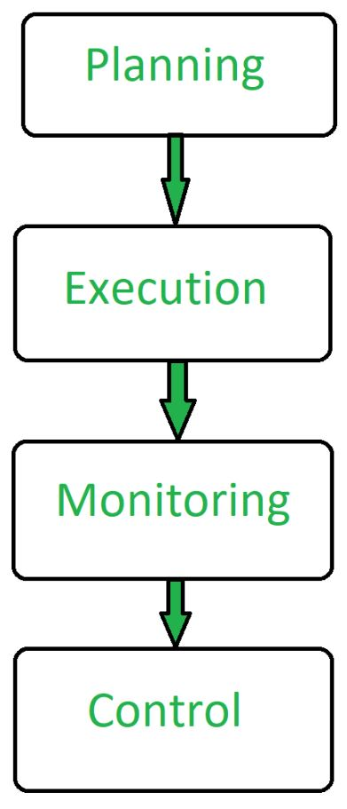
Aspects of Software Project Management:
Advantages of Software Project Management:
It helps in planning of software development.
Implementation of software development is made easy.
Monitoring and controlling are aspects of software project management.
It overall manages to save time and cost for software development.

Slide 28
4 Ps of Project Management
4 Ps are :-
Product –It refers to the result of the project, the purpose of the project. The project manager needs to explain the product scope so that everyone is clear on the end results. The product refers to be both tangible and intangible.
Process - A clearly defined and mapped out process is the key to the success of any project. It factors in issues, hurdles and probable solutions to ensure minimum disruption. Each stage of the process in the project needs to be mapped so that everyone knows what to do and how to do it. The correct process strategy leads to the proper execution of the project hence success.

Slide 29
4 Ps of Project Management
People - The most critical component of a project and its successful implementation is human resources. A well-managed team with clear cut roles defined for each person/team will lead to the success of the project. Some of the assigned roles in project management are project manager, team members, stakeholders, process analysts, and information technology personnel. Managing people successfully is tricky and a role played well by good project managers.
Project – The fourth but not the least component is the project. This is where the big role and responsibility of the project manager are under the spotlight. The manager is also known as PM informally, has the task of overseeing the project, delegating tasks, guiding and assisting team members with issues, checking on budget, and trying to ensure the project stays on track with the well-defined deadlines.

Slide 30
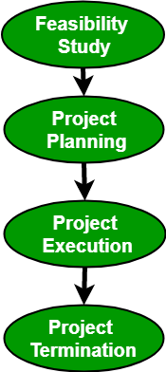
Project Management Process
The Project Management Process consists of the following 4 stages:
Feasibility study –
A feasibility study explores system requirements to determine project feasibility.
The goal is to determine whether the system can be implemented or not.
The process of feasibility study takes as input the required details as specified by the user and other domain-specific details. The output of this process simply tells whether the project should be undertaken or not and if yes, what would the constraints be. Project Planning

Slide 31
Project Management Process
Project Planning
Planning consists of the following activities:
Set objectives or goals
Develop strategies
Develop project policies
Determine courses of action
Making planning decisions
Set procedures and rules for the project
Develop a software project plan
Prepare budget
Conduct risk management
Document software project plan
This step also involves the construction of a work breakdown structure(WBS). It also includes size, effort, schedule, and cost estimation using various techniques.

Slide 32
Project Management Process
Project Execution
A project is executed by choosing an appropriate software development lifecycle model(SDLC).
It includes a number of steps including requirements analysis, design, coding, testing and implementation, testing, delivery, and maintenance.
There are a number of factors that need to be considered while doing so including the size of the system, the nature of the project, time and budget constraints, domain requirements, etc.
Project Termination
Some of the reasons for failure include:
Fast-changing technology
Project running out of time
Organizational politics
Too much change in customer requirements
Project exceeding budget or funds

Slide 33
Software Measurement and Metrics
Measurement
Measurement is fundamental to any engineering discipline
Software Metrics – Broad range of measurements for computer software
Software Process – Measurement can be applied to improve it on a continuous basis
Software Project – Measurement can be applied in estimation, quality control, productivity assessment and project control
Measurement can be used by software engineers in decision making.

Slide 34
Software Measurement and Metrics (Definitions)
Measure – Quantitative indication of the extent, amount, dimension, capacity or size of some attribute of a product or process
Measurement – The act of determining a measure
Metric – A quantitative measure of the degree to which a system, component, or process possesses a given attribute.
Indicator – An indicator is a metric or combination of metrics that provide insight into the software process, a software project or the product itself.

Slide 35
Why Do We Measure?
To indicate the quality of the product.
To assess the productivity of the people who produce the product
To assess the benefits derived from new software engineering methods and tools
To form a baseline for estimation
To help justify requests for new tools or additional training

Slide 36
Types of Metrics
Process Metrics
Can be used to improve software development and maintenance.
Examples include the effectiveness of defect removal during development, the pattern of testing defect arrival, and the response time of the fix process.
Product Metrics
Describe the characteristics of the product such as size, complexity, design features, performance, and quality level.
Project Metrics
Describe the project characteristics and execution.
Examples include the number of software developers, the staffing pattern over the life cycle of the software, cost, schedule, and productivity.

Slide 37
Process Metrics
Process metrics are measures of the software development process, such as
Overall development time
Type of methodology used
Process metrics are collected across all projects and over long periods of time.
Their intent is to provide indicators that lead to long-terms software process improvement.

Slide 38
Project Metrics
Project Metrics are the measures of Software Project and are used to monitor and control the project. They enable a software project manager to:
Minimize the development time by making the adjustments necessary to avoid delays and potential problems and risks.
Assess product quality on an ongoing basis & modify the technical approach to improve quality.

Slide 39
Project Metrics
Used in estimation techniques & other technical work
Metrics collected from past projects are used as a basis from which effort and time estimates are made from current software project.
As a project proceeds, actual values of human effort & calendar time expended are compared to the original estimates.
The data is used by the project manager to monitor & control the project.

Slide 40
Product Metrics
Product metrics are measures of the software product at any stage of its development, from requirements to installed system. Product metrics may measure:
The complexity of the software design
The size of the final program
The number of pages of documentation produced

Slide 41
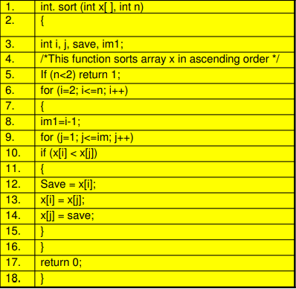
Size Estimation
Lines of Code (LOC)
This metric measures the size of a project by counting the number of source instructions in the developed program. Obviously, while counting the number of source instructions, comment lines, and header lines are ignored.
When comments and blank lines are ignored, the program in figure shown below contains 17 LOC.

Slide 42
Size Estimation
Function Point (FP) metric
The size of a software product (in units of function points or FPs) is computed using different characteristics of the product identified in its requirements specification. It is computed using the following three steps:
Step 1: Compute the unadjusted function point (UFP) using a heuristic expression.
Step 2: Refine UFP to reflect the actual complexities of the different parameters used in UFP computation.
Step 3: Compute FP by further refining UFP to account for the specific characteristics of the project that can influence the entire development effort.

Slide 43
Size Estimation(FP)
Function Count
Alan Albrecht while working for IBM, recognized the problem in size measurement in the 1970s, and developed a technique (which he called Function Point Analysis), which appeared to be a solution to the size measurement problem
The principle of Albrecht’s function point analysis (FPA) is that a system is decomposed into functional units.
Inputs : information entering the system
Outputs : information leaving the system
Enquiries : requests for instant access to information
Internal logical files : information held within the system
External interface files : information held by other system that is used by the system being analyzed.

Slide 44


Size Estimation(FP)
The five functional units are divided in two categories:
Data function types
Internal Logical Files (ILF): A user identifiable group of logical related data or control information maintained within the system. Software Project Planning
External Interface files (EIF): A user identifiable group of logically related data or control information referenced by the system, but maintained within another system. This means that EIF counted for one system, may be an ILF in another system.

Slide 45

Size Estimation(FP)
(ii) Transactional function types
External Input (EI): An EI processes data or control information that comes from outside the system. The EI is an elementary process, which is the smallest unit of activity that is meaningful to the end user in the business.
External Output (EO): An EO is an elementary process that generate data or control information to be sent outside the system.
External Inquiry (EQ): An EQ is an elementary process that is made up to an input-output combination that results in data retrieval.

Slide 46
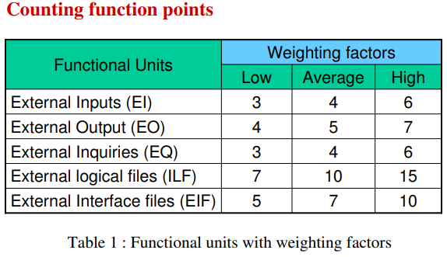
Size Estimation(FP)

Slide 47
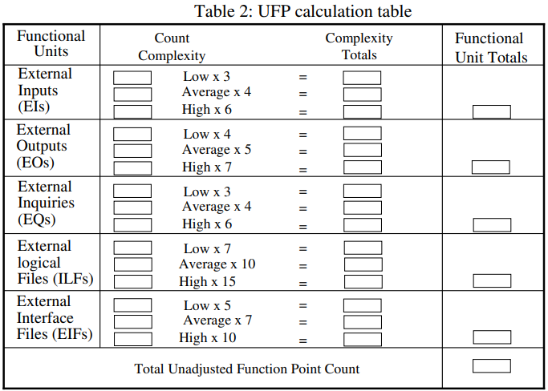
Size Estimation(FP)

Slide 48
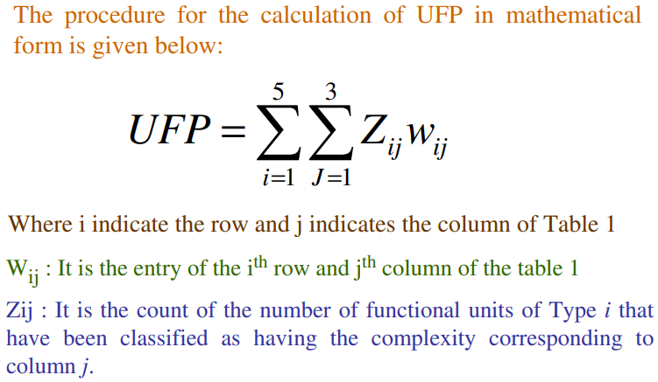
Size Estimation(FP)

Slide 49
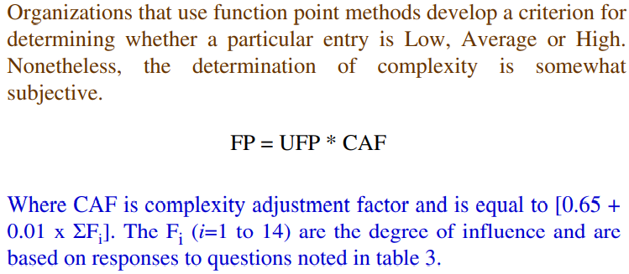
Size Estimation(FP)

Slide 50
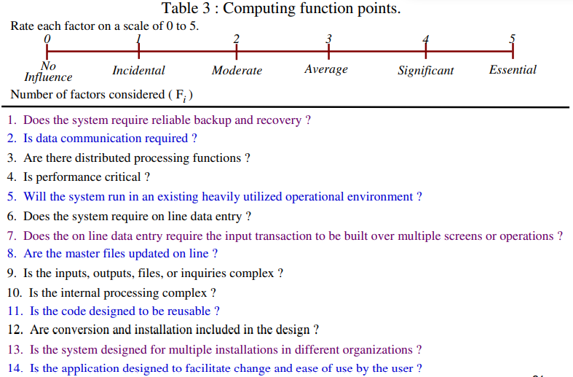
Size Estimation(FP)

Slide 51
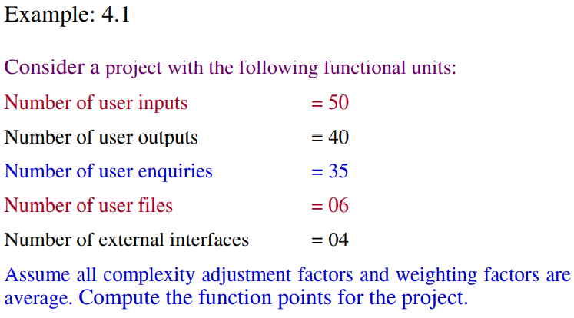
Size Estimation(FP)

Slide 52
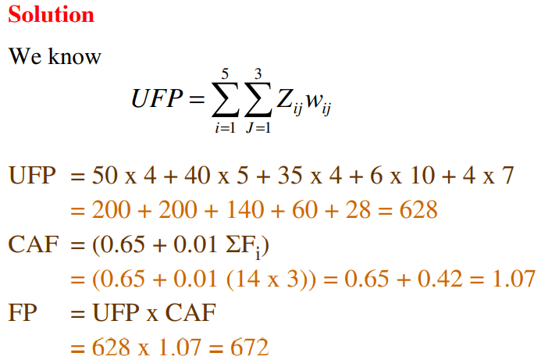
Size Estimation(FP)

Slide 53
Halstead’s Software Science
According to Halstead's "A computer program is an implementation of an algorithm considered to be a collection of tokens which can be classified as either operators or operand.“
Token Count
In these metrics, a computer program is considered to be a collection of tokens, which may be classified as either operators or operands. All software science metrics can be defined in terms of these basic symbols. These symbols are called as a token.
The basic measures are
n1 = count of unique operators. n2 = count of unique operands. N1 = count of total occurrences of operators. N2 = count of total occurrence of operands.
In terms of the total tokens used, the size of the program can be expressed as
N = N1 + N2.

Slide 54
Halstead Metrics
Program Volume (V)
The unit of measurement of volume is the standard unit for size "bits." It is the actual size of a program if a uniform binary encoding for the vocabulary is used.
V=N*log₂n
Program Level (L)
The value of L ranges between zero and one, with L=1 representing a program written at the highest possible level (i.e., with minimum size)
L=V*/V

Slide 55
Halstead Metrics contd…
Program Difficulty
The difficulty level or error-proneness (D) of the program is proportional to the number of the unique operator in the program.
D= (n1/2) * (N2/n2)
Programming Effort (E)
The unit of measurement of E is elementary mental discriminations.
E=V/L=D*V

Slide 56
Halstead Metrics contd…
Estimated Program Length
According to Halstead, The first Hypothesis of software science is that the length of a well-structured program is a function only of the number of unique operators and operands.
N=N1+N2
And estimated program length is denoted by N^
N^ = n1log₂n1 + n2log₂n2
The following alternate expressions have been published to estimate program length:
N_{J} = log₂ (n1!) + log₂ (n2!)
N_{B} = n1 * log₂n2 + n2 * log2n1
N_{C} = n1 * sqrt(n1) + n2 * sqrt(n2)
N_{S} = (n * log₂n) / 2

Slide 57
Halstead Metrics contd…
Potential Minimum Volume
The potential minimum volume V* is defined as the volume of the most short program in which a problem can be coded.
V* = (2 + n2*) * log₂ (2 + n2*)
Here, n2* is the count of unique input and output parameters
Size of Vocabulary (n)
The size of the vocabulary of a program, which consists of the number of unique tokens used to build a program, is defined as:
n=n1+n2
where
n=vocabulary of a program n1=number of unique operators n2=number of unique operands

Slide 58
Cyclomatic Complexity Measures
Cyclomatic complexity is software metric (measurement). It was developed by Thomas J. McCabe, in 1976 and is used to indicate the complexity of a program.
Cyclomatic complexity is a software metric used to measure the complexity of a program. These metric, measures independent paths through program source code.
Independent path is defined as a path that has at least one edge which has not been traversed before in any other paths.
Cyclomatic complexity can be calculated with respect to functions, modules, methods or classes within a program.

Slide 59
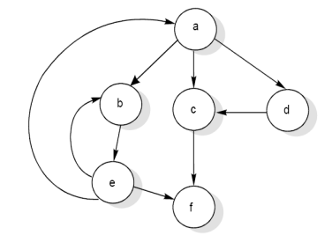
Cyclomatic Complexity Measures
McCabe’s cyclomatic metric V(G) = e – n + 2P.
Where, e – number of flow graph edges
n – number of flow graph nodes
Flow Graph

Slide 60
Cyclomatic Complexity Measures
The value of cyclomatic complexity can be calculated as :
V(G) = 9 – 6 + 2 = 5
Here e = 9, n = 6 and P =1
There will be five independent paths for the flow graph.
Path 1 : a c f
Path 2 : a b e f
Path 3 : a d c f
Path 4 : a b e a c f or a b e a b e f
Path 5 : a b e b e f

Slide 61
Properties of Cyclomatic Complexity
Several properties of cyclomatic complexity are stated below:
V(G) ≥1
V (G) is the maximum number of independent paths in graph G.
Inserting & deleting functional statements to G does not affect V(G).
G has only one path if and only if V(G)=1.
Inserting a new row in G increases V(G) by unity.
V(G) depends only on the decision structure of G.

Slide 62
Software Project Planning Activities
1. Identify project scope and objectives Establish a project authority © Identify all stakeholders in the project and their interests © Modify objectives in the light of stakeholders analysis © Establish methods of communications with all parties. 2. Identify project infrastructure © Establish relationship between project and strategic planning © Identify installation standards and procedures © Identify project team organization

Slide 63
Software Project Planning Activities
Analyze project characteristics Distinguish the project as either objective or product driven © Analise other project characteristics, © Identify high level project risks © Take into account user requirement concerning implementation © Select general lifecycle approach © Review overall resource estimates
Identify project products and activities © Identify and describe project products © Document generic product flows © Recognize product instances © Produce Ideal activity network © Modify ideal to take into account need for stages and check
Estimate effort for each activity © Carry out bottom up estimates © Revise plan to create controllable activities
Identify activity risks
assessed for potential risks, such as technical challenges, resource constraints, or dependencies on other activities.
project team to develop mitigation strategies

Slide 64
Allocate resource
resources such as manpower, equipment, and budget need to be allocated accordingly.
Balancing resource allocation ensures that tasks are completed efficiently without overburdening team members or exceeding budget limits.
Review/ Publicize plan
project plan should be reviewed by stakeholders
communicating the project timeline, deliverables, and responsibilities to all stakeholders,
Execute plan
the project team can begin executing the activities according to the schedule.
Project should be monitored regularly to track milestones, identify any deviations from the plan, and implement corrective actions as needed.

Slide 65
Single and Multivariable Models
In software project management, single and multivariable models are used for cost estimation, which is a critical aspect of project planning. These models help predict the cost and effort required to develop a software project.
Static, Single Variable Models
Static, Multi Variable Models

Slide 66
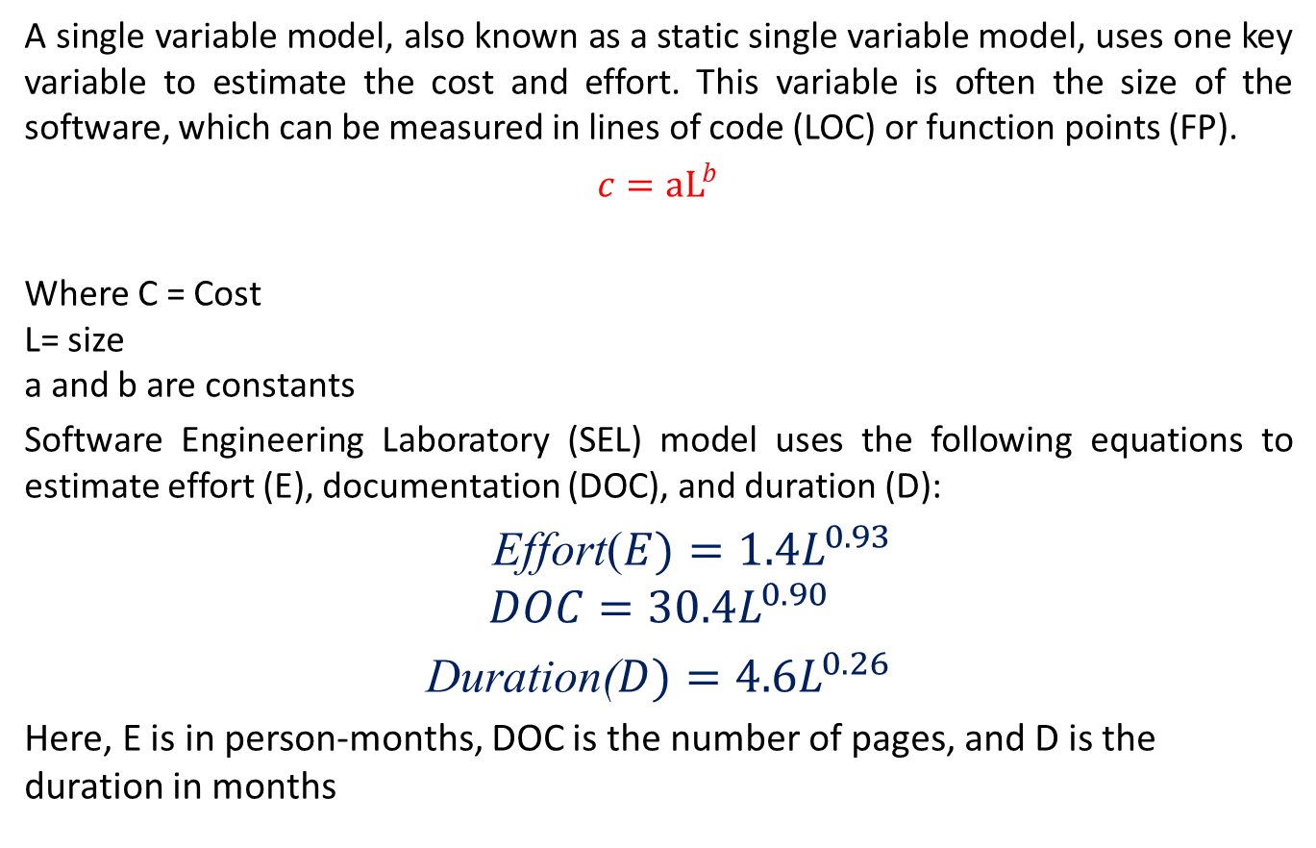
Static, Single Variable Models
A single variable model, also known as a static single variable model, uses one key variable to estimate the cost and effort. This variable is often the size of the software, which can be measured in lines of code (LOC) or function points (FP).
$c=aL^{b}$
Where C = Cost L= size a and b are constants
Software Engineering Laboratory (SEL) model uses the following equations to estimate effort (E), documentation (DOC), and duration (D):
Effort($E)={1.4L}^{0.93}$
$$DOC={30.4L}^{0.90}$$
Duration($D)={4.6L}^{0.26}$
Here, E is in person-months, DOC is the number of pages, and D is the duration in months

Slide 67
Static, Multi Variable Models
A multivariable model, on the other hand, considers several variables that represent different aspects of the software development environment. This model is more complex and provides a more appropriate estimation by taking into account factors such as team experience, project complexity, and technology constraints. The equations for a multivariable model might look like this:
E= 5.2 L^{0.91}
D= 4.1 L^{0.36}
Where E is the effort in person-months and D is the duration in months. These equations show that the effort and duration are influenced by the size of the software and other factors represented by the constants and exponents in the equations
Ex: COCOMO model

Slide 68
COCOMO
The COCOMO (Constructive Cost Model) is a procedural cost estimate model for software projects.
It is often used as a process of reliably predicting the various parameters associated with making a project such as size, effort, cost, time, and quality.
Proposed by Barry Boehm in 1981, it is based on the study of 63 projects, making it one of the best-documented models.
Key Parameters
Effort: Amount of labor required to complete a task, measured in person-months units.
Schedule: Amount of time required for the completion of the job, which is proportional to the effort put in. It is measured in units of time such as weeks, and months.

Slide 69
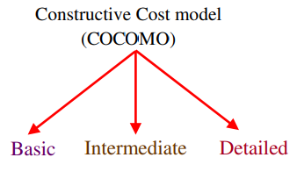
Types of COCOMO Model
Organic: A software project is considered organic if the team size required is adequately small, the problem is well understood and has been solved in the past, and the team members have a nominal experience regarding the problem.
Semi-detached: A software project is considered semi-detached if the vital characteristics such as team size, experience, and knowledge of the various programming environments lie in between organic and embedded.
Embedded: A software project requiring the highest level of complexity, creativity, and experience requirement falls under this category.

Slide 70
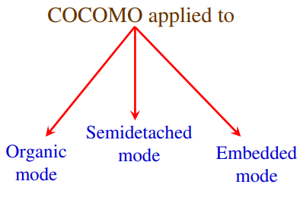
COCOMO
The Constructive Cost Model (COCOMO)

Slide 71
Comparison of Three COCOMO modes
Mode | Project size | Nature of Project | Innovation | Deadline of the project | Development Environment
Organic | Typically 2-50 KLOC | Small size project, experienced developers in the familiar environment. For example, pay roll, inventory projects etc. | Little | Not tight | Familiar & In house
Semi detached | Typically 50-300 KLOC | Medium size project, Medium size team, Average previous experience on similar project. For example: Utility systems like compilers, database systems, editors etc. | Medium | Medium | Medium
Embedded | Typically over 300 KLOC | Large project, Real time systems, Complex interfaces, Very little previous experience. For example: ATMs, Air Traffic Control etc. | Significant | Tight | Complex Hardware/ customer Interfaces required

Slide 72
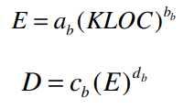
Basic Model
Basic COCOMO model takes the form
where E is effort applied in Person-Months, and D is the development time in months. The coefficients a_{b}, b_{b}, c_{b} and d_{b} are given in table.

Slide 73
Basic COCOMO coefficient
Software Project | a_{b} | b_{b} | c_{b} | d_{b}
Organic | 2.4 | 1.05 | 2.5 | 0.38
Semidetached | 3.0 | 1.12 | 2.5 | 0.35
Embedded | 3.6 | 1.20 | 2.5 | 0.32

Slide 74
Basic COCOMO coefficient
When effort and development time are known, the average staff size to complete the project may be calculated as:
E
Average staff size (SS ) =
Persons
D
When project size is known, the productivity
level may be
calculated as:
Productivity (P) = ^{KLOC} KLOC / PM
E

Slide 75
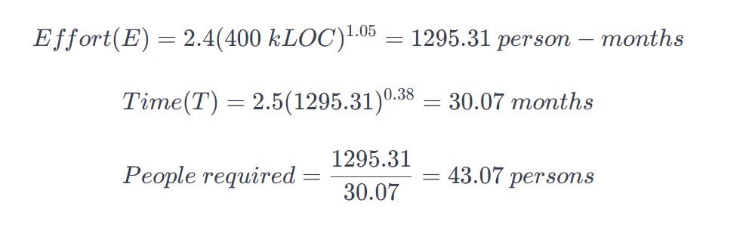
BASIC COCOMO model
Suppose a project was estimated to be made in 400 kLOC. Lets calculate its effort, time, and the number of people required while considering the project is of organic type:

Slide 76
Intermediate Model
Intermediate Model: The basic COCOMO model considers that the effort is only a function of the number of lines of code and some constants calculated according to the various software systems. The Intermediate COCOMO model builds upon the Basic COCOMO model by considering additional factors that influence software development effort.
It incorporates 15 different cost drivers, including team size, experience, tools used, and more.
These factors help in providing a more refined estimation of effort and project duration.

Slide 77
Multipliers of different cost drivers
Cost Drivers | RATINGS
 | Very low | Low | Nominal | High | Very high | Extra high
Product Attributes
RELY | 0.75 | 0.88 | 1.00 | 1.15 | 1.40 | --
DATA | -- | 0.94 | 1.00 | 1.08 | 1.16 | --
CPLX | 0.70 | 0.85 | 1.00 | 1.15 | 1.30 | 1.65
Computer Attributes
TIME | -- | -- | 1.00 | 1.11 | 1.30 | 1.66
STOR | -- | -- | 1.00 | 1.06 | 1.21 | 1.56
VIRT | -- | 0.87 | 1.00 | 1.15 | 1.30 | --
TURN | -- | 0.87 | 1.00 | 1.07 | 1.15 | --

Slide 78
Multipliers of different cost drivers
Cost Drivers | RATINGS
 | Very low | Low | Nominal | High | Very high | Extra high
Personnel Attributes
ACAP | 1.46 | 1.19 | 1.00 | 0.86 | 0.71 | --
AEXP | 1.29 | 1.13 | 1.00 | 0.91 | 0.82 | --
PCAP | 1.42 | 1.17 | 1.00 | 0.86 | 0.70 | --
VEXP | 1.21 | 1.10 | 1.00 | 0.90 | -- | --
LEXP | 1.14 | 1.07 | 1.00 | 0.95 | -- | --
Project Attributes
MODP | 1.24 | 1.10 | 1.00 | 0.91 | 0.82 | --
TOOL | 1.24 | 1.10 | 1.00 | 0.91 | 0.83 | --
SCED | 1.23 | 1.08 | 1.00 | 1.04 | 1.10 | --

Slide 79
Intermediate COCOMO equations
E = a (KLOC)^{bi} * EAF
i
D = c (E)^{di}
Project | a_{i} | b_{i} | c_{i} | d_{i}
Organic | 3.2 | 1.05 | 2.5 | 0.38
Semidetached | 3.0 | 1.12 | 2.5 | 0.35
Embedded | 2.8 | 1.20 | 2.5 | 0.32

Slide 80
Detailed COCOMO Model
The detailed model incorporates all the features of the intermediate version but takes it a step further.
It assesses the impact of each cost driver on every step of the software engineering process.
Effort multipliers are used for each cost driver attribute, allowing for a more precise estimation.
This model requires a detailed understanding of the project and its specific attributes

Slide 81
Detailed COCOMO Model
Detailed COCOMO
Phase-Sensitive effort multipliers
Three level product hierarchy
Modules subsystem
Cost drivers
design & test
System level
Manpower allocation for each phase

Slide 82
Detailed COCOMO Model
Development Phase
Plan / Requirements
EFFORT DEVELOPMENT TIME
% depend on mode & size
: 6% to 8%
: 10% to 40%

Slide 83
Detailed COCOMO Model
Design
Effort Time
:
:
16% to 18%
19% to 38%
Programming
Effort Time
:
:
48% to 68%
24% to 64%
Integration & Test
Effort Time
:
:
16% to 34%
18% to 34%

Slide 84
Detailed COCOMO Model
Principle of the effort estimate
Size equivalent
As the software might be partly developed from software already existing (that is, re-usable code), a full development is not always required. In such cases, the parts of design document (DD%), code (C%) and integration (I%) to be modified are estimated. Then, an adjustment factor, A, is calculated by means of the following equation.
A = 0.4 DD + 0.3 C + 0.3 I
The size equivalent is obtained by
S (equivalent) = (S x A) / 100
E_{p} = μ _{p} E
D_{p} = τ _{p} D

Slide 85
Staffing Level Estimation
Staffing level estimation involves determining the number of personnel required throughout a software development project. It’s essential for effective resource allocation and project planning.
Key points related to staffing level estimation:
The number of personnel is not constant throughout the project lifecycle.
Different project phases require varying team sizes:
Planning and analysis: Performed by a small group of people.
Architectural design: Involves a larger group.
Detailed design: Requires a large number of people.
Implementation and system testing: Demand the largest team size.
Maintenance: May need personnel but decreases over time.

Slide 86
Rayleigh curve
The Rayleigh curve is used to estimate staffing levels. It represents the number of full-time equivalent personnel at different points in time during the project.
Parameters of the Rayleigh curve:
(t_d): Time at which the curve reaches its maximum value.
(K): Total effort required for the project.
Lawrence Putnam’s interpretation of the Rayleigh curve provides insights into personnel requirements throughout the project life cycle.
The curve accurately estimates personnel needs during the development cycle, from architectural design through implementation and system testing

Slide 87












Resource Allocation Model (CO5)
Norden of IBM
Rayleigh curve
Model for a range of hardware development projects.
Overall Curve Design and Coding
Persons
Time
The Rayleigh manpower loading curve

Slide 88
Resource Allocation Model
The Norden / Rayleigh Curve
The curve is modeled by differential equation
m(t) = ^{dy} = 2kate^{−at 2}
dt
_{dt} = manpower utilization rate per unit time
a = parameter that affects the shape of the curve
K = area under curve in the interval [0, ∞ ]
t = elapsed time

Slide 89
The Norden / Rayleigh Curve
The curve is characterized by a gradual increase in manpower/resources at the beginning of the project, followed by a peak period of high resource utilization, and then a gradual decrease as the project nears completion.
It's often used to identify peak resource requirements and to plan resource allocation accordingly to avoid overloading or underutilization of resources.
The Rayleigh curve is particularly useful in industries where manpower/resource allocation plays a crucial role, such as construction, manufacturing, and engineering projects. By understanding the manpower loading curve, project managers can make informed decisions about staffing levels, scheduling, and resource allocation to ensure project efficiency and success.

Slide 90
Resource Allocation Model
a=2
a=0.5
a=0.222
m (t) Person
a=0.125
Time (years)
Fig: Influence of parameter ‘a’ on the manpower distribution

Slide 91
Effective team structures
Effective team structures are crucial for successful software development. Here are some common team structures:
Functional Teams:
Organized by specialized functions (e.g., development, testing, design).
Each team focuses on a specific aspect of the project.
Communication across teams is essential.
Cross-Functional Teams:
Composed of members with diverse skills (e.g., developers, testers, designers).
Collaborate closely to deliver features or modules.
Promotes faster decision-making and adaptability.

Slide 92
Effective team structures
Matrix Teams:
Combine functional and project-based structures.
Team members report to both functional managers and project managers.
Provides flexibility but can lead to conflicts.
Agile Teams:
Self-organizing, cross-functional teams.
Work iteratively in sprints or time-boxed cycles.
Emphasize collaboration, communication, and adaptability.

Slide 93
Effective team structures
Virtual Teams:
Geographically dispersed members collaborate remotely.
Use communication tools and virtual meetings.
Requires strong communication skills and trust.
Project Teams:
Formed for a specific project.
Members work exclusively on that project.
Disband after project completion.
Product Teams:
Responsible for a product’s entire lifecycle.
Include development, maintenance, and support.
Long-term focus on product improvement.

Slide 94
Risk analysis and management (CO5)
What is risk ?
Tomorrow’s problems are today’s risks.
“Risk is a problem that may cause some loss or threaten the success of the project, but which has not happened yet”.

Slide 95
Risk analysis and management
Risk management is the process of identifying addressing and eliminating these problems before they can damage the project.
Current problems &
Potential Problems

Slide 96
Risk analysis and management
Typical Software Risk
Capers Jones has identified the top five risk factors that threaten projects in different applications
1. Dependencies on outside agencies or factors.
Availability of trained, experienced persons
Inter group dependencies
Customer-Furnished items or information
Internal & external subcontractor relationships

Slide 97
Risk analysis and management
2.
Requirement issues
Uncertain requirements
Wrong product
or
Right product badly
Either situation results in unpleasant surprises and unhappy customers.

Slide 98
Risk analysis and management
2.
Requirement issues
Uncertain requirements
Wrong product
or
Right product badly
Either situation results in unpleasant surprises and unhappy customers.

Slide 99
Risk analysis and management
3. Management Issues
Project managers plans, and most
usually write the risk management people do not wish to air their
weaknesses in public.
Inadequate planning
Inadequate visibility into actual project status
Unclear project ownership and decision making
Staff personality conflicts
Unrealistic expectation
Poor communication

Slide 100
Risk analysis and management
4. Lack of knowledge
Inadequate training
Poor understanding of methods, tools, and techniques
Inadequate application domain experience
New Technologies
Ineffective, poorly documented or neglected processes

Slide 101
Risk analysis and management
5.
Other risk categories
Unavailability of adequate testing facilities
Turnover of essential personnel
Unachievable performance requirements
Technical approaches that may not work

Slide 102
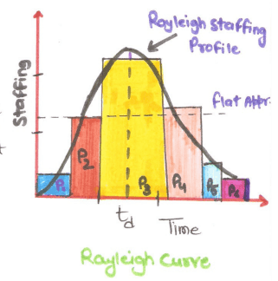
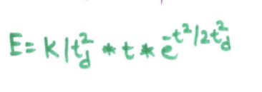
Staffing level Estimation: NORDEN WORK
Project manager has to figure out Staff Estimation after the effort required to develop a software has been determined.
Norden investigated the staffing pattern of R & D project.
Norden Estimation:
He studied the Staffing patterns of R & D projects and proposed that Staffing level patterns can be approximated by the "Rayleigh Distribution Curve" which specifies that the relationship between applied effort and delivery time for software project.
It is also called Putnam- NORDEN-Rayleigh Curve or PNR curve.
He represented the Rayleigh Curve by this equation
Here E is the effort required at time t.(engineers and staffs)
K= Area under curve.
t_{d}= time at with the curve attains its maximum values.

Slide 103
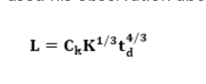
Staffing Level Estimation: Putnam's Work
Putnam analyzed that characteristic of software development and staffing has some characteristics of R and D projects studied by Norden and Rayleigh Norden Curve can be used to Relate the Number of delivered lines of code to the effort and the time required to develop the project.
k= total effort expended in PM in product development.
L= the product size in KLOC
t_{d}= time required to develop the software
C_{k} = state of Technology constraints
like C_{k} =2(poor development environment)
C_{k} =8 (good software development environment)
C_{k} =11 (Excellent environment)

Slide 104
Risk analysis and management
Risk Identification
Risk Assessment
Risk Analysis
Risk Prioritization
Risk Management
Risk Management Planning
Risk Control
Risk Monitoring
Risk Resolution
Fig. Risk Management Activities

Slide 105
Risk analysis and management
A software project can be affected by a large variety of risks. The project manager can then examine which risks from each class are relevant to the project.
Project risks Project risks concern varies forms of budgetary, schedule, personnel, resource, and customer-related problems.
Technical risks Technical risks concern potential design, implementation, interfacing, testing, and maintenance problems. Technical risks also include ambiguous specification, incomplete specification, changing specification, technical uncertainty, and technical obsolescence.
Business risks This type of risks include risks of building an excellent product that no one wants, losing budgetary or personnel commitments, etc

Slide 106
Risk Assessment
The objective of risk assessment is to rank the risks in terms of their damage causing potential. For risk assessment, first each risk should be rated in two ways:
• The likelihood of a risk coming true (denoted as r). • The consequence of the problems associated with that risk (denoted as s).
Based on these two factors, the priority of each risk can be computed:
p = r * s

Slide 107
Risk Containment
After all the identified risks of a project are assessed, plans must be made to contain the most damaging and the most likely risks. Different risks require different containment procedures. In fact, most risks require ingenuity on the part of the project manager in tackling the risk. There are three main strategies to plan for risk containment:
Avoid the risk- This may take several forms such as discussing with the customer to change the requirements to reduce the scope of the work, giving incentives to the engineers to avoid the risk of manpower turnover, etc.
Transfer the risk- This strategy involves getting the risky component developed by a third party, buying insurance cover, etc.
Risk reduction- This involves planning ways to contain the damage due to a risk. For example, if there is risk that some key personnel might leave, new recruitment may be planned.

Slide 108
Risk Leverage
Risk leverage refers to the concept of utilizing various strategies or measures to mitigate or manage risks effectively within software development projects . It involves identifying potential risks, evaluating their impact, and implementing countermeasures to reduce the likelihood or severity of adverse outcomes. To choose between the different strategies of handling a risk, the project manager must consider the cost of handling the risk and the corresponding reduction of risk.

Slide 109
Risk related to schedule slippage
Schedule slippage refers to the delay in completing tasks or milestones beyond their originally planned completion dates. It can happen during project planning or execution, resulting in a gap between scheduled and actual completion times.
As an example, it can be considered the options available to contain an important type of risk that occurs in many software projects – that of schedule slippage. Risks relating to schedule slippage arise primarily due to the intangible nature of software.
Steps to manage schedule slippage
Every phase can be broken down to reasonable-sized tasks and milestones can be scheduled for these tasks too.
A milestone is reached, once documentation produced as part of a software engineering task is produced and gets successfully reviewed.
Milestones need not be placed for every activity. An approximate rule of thumb is to set a milestone every 10 to 15 days.

Slide 110
Configuration Management
The results (also called as the deliverables) of a large software development effort typically consist of a large number of objects, e.g. source code, design document, SRS document, test document, user’s manual, etc. These objects are usually referred to and modified by a number of software engineers through out the life cycle of the software. The state of all these objects at any point of time is called the configuration of the software product. The state of each deliverable object changes as development progresses and also as bugs are detected and fixed.
Configuration Management Activities
The activities are divided into four broad categories.
The identification of the components and changes
The control of the way by which the changes are made
Auditing the changes
Status accounting recording and documenting all the activities that have take place

Slide 111
Configuration Management
The following documents are required for these activities
Project plan
Software requirements specification document
Software design description document
Source code listing
Test plans / procedures / test cases
User manuals

Slide 112
Configuration Management
Software Versions
Two types of versions namely revisions (replace) and variations (variety).
Version Control :
A version control tool is the first stage towards being able to manage multiple versions. Once it is in place, a detailed record of every version of the software must be kept. This comprises the
Name of each source code component, including the variations and revisions
The versions of the various compilers and linkers used
The name of the software staff who constructed the component
The date and the time at which it was constructed

Slide 113
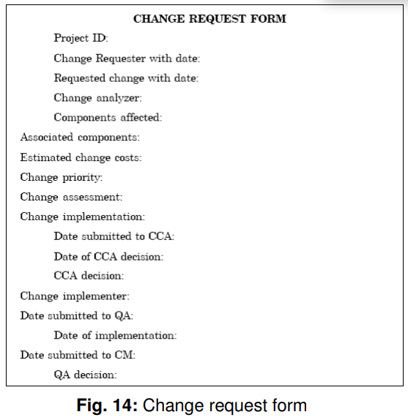
Configuration Management
Change Control Process
Change control process comes into effect when the software and associated documentation are delivered to configuration management change request form, which should record the recommendations regarding the change.

Slide 114
Software Re-engineering
Software re-engineering is concerned with taking existing legacy systems and re-implementing them to make them more maintainable.
The critical distinction between re-engineering and new software development is the starting point for the development as shown in Fig. in next slide

Slide 115
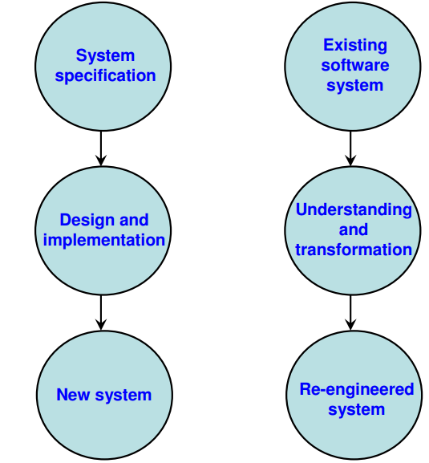
Software Re-engineering
It is the combination of two consecutive process
Forward Engineering
Reverse Engineering

Slide 116
Software Re-engineering
Objective of Re-engineering
Prepare Functional Enhancement: Identify areas for improvement to make the system more efficient and effective.
Improve Maintainability: Simplify the system to reduce complexity and ensure easier updates and error corrections.
Enhance Skills of Software Developers: Enable developers to adopt and adapt to cutting-edge technologies seamlessly.
Improve Reliability: Increase the system’s robustness and ensure consistent performance over time.
Apply Integration :Incorporate seamless compatibility across different systems and technologies.

Slide 117
Software Re-engineering
Steps in Re-engineering
Goal Setting: Define clear objectives aligned with organizational needs and desired outcomes.
Critical Analysis of Existing Scenario: Evaluate current processes, tasks, designs, and methods to identify inefficiencies.
Identifying Problems and Innovative Solutions: Pinpoint bottlenecks and apply creative thinking to introduce novel solutions for improved outcomes.

Slide 118
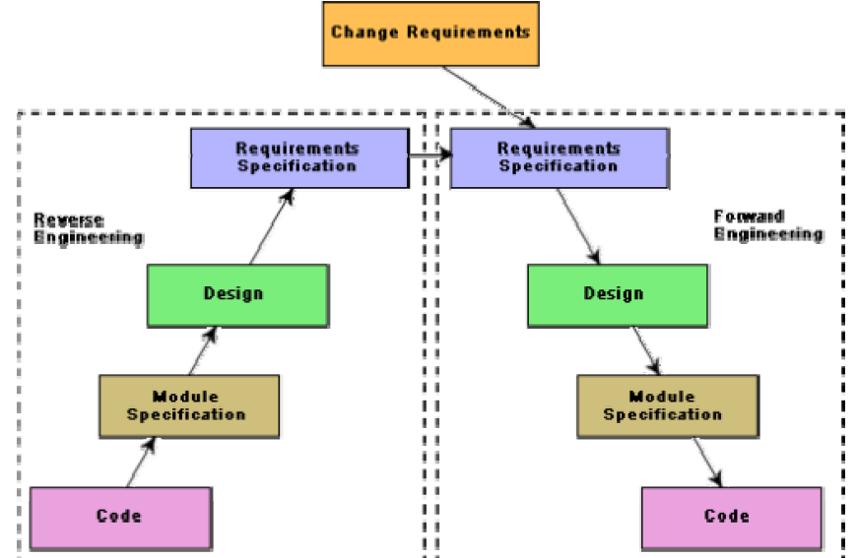
Software Re-engineering

Slide 119
Software Re-engineering
The following suggestions may be useful for the modification of the legacy code:
Study code well before attempting changes
Concentrate on overall control flow and not coding
Heavily comment internal code
Create Cross References
Build Symbol tables
Use own variables, constants and declarations to localize the effect
Keep detailed maintenance document
Use modern design techniques

Slide 120
Reverse Engineering
Reverse Engineering
Reverse engineering is the process followed in order to find difficult, unknown and hidden information about a software system.
Scope and Task
The areas there reverse engineering is applicable include (but not limited to):
Program comprehension
Redocumentation and/ or document generation
Recovery of design approach and design details at any level of abstraction
Identifying reusable components
Identifying components that need restructuring
Recovering business rules, and
Understanding high level system description

Slide 121
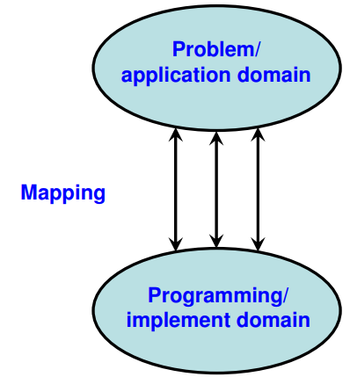
Reverse Engineering
Reverse Engineering encompasses a wide array of tasks related to understanding and modifying software system. This array of tasks can be broken into a number of classes.
Mapping between application and program domains

Slide 122
Reverse Engineering
Mapping Between Application and Program Domains
Application Domain: Refers to the real-world context, requirements, and business logic the software is designed to address.
Program Domain: Focuses on the technical implementation, including source code, architecture, and algorithms.
Mapping Significance:
Bridging the gap between what the software does (application domain) and how it is implemented (program domain).
Ensures alignment between user needs and technical solutions.
Simplifies maintenance, debugging, and enhancement by offering clarity on the relationship between design and functionality.

Slide 123
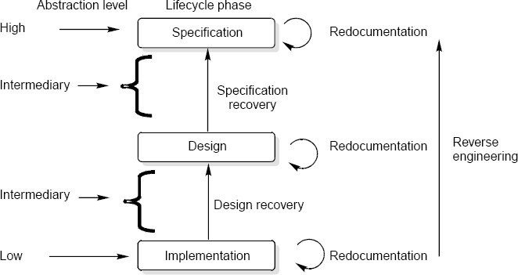
Reverse Engineering

Slide 124
Reverse Engineering
In it, the old code is analyzed (abstracted) to extract the module specifications.
The module specifications are then analyzed to produce the design.
The design is analyzed (abstracted) to produce the original requirements specification.
The change requests are then applied to this requirements specification to arrive at the new requirements specification.
At the design, module specification, and coding a substantial reuse is made from the reverse engineered products.
Advantage
it produces a more structured design compared to what the original product had,
It produces good documentation, and very often results in increased efficiency.

Slide 125
Clean Room Software Engineering
clean room approach was developed by Dr. Harlan Mills of IBM’s Federal Systems Division, and it was released in the year 1981 but got popularity after 1987
Clean room software engineering is a software development approach to producing quality software.
It is different from classical software engineering as in classical software engineering QA (Quality Assurance) is the last phase of development that occurs at the completion of all development stages while there is a chance of less reliable and fewer quality products full of bugs, and errors and upset client, etc. But in clean room software engineering, an efficient and good quality software product is delivered to the client as QA (Quality Assurance) is performed each and every phase of software development.

Slide 126
Process of Clean Room Development
Clean room software development approaches consist of four key processes i.e.
Management – It is persistent throughout the whole project lifetime which consists of project mission, schedule, resources, risk analysis, training, configuration management, etc.
Specification – It is considered the first process of each increment which consists of requirement analysis, function specification, usage specification, increment planning, etc.

Slide 127
Process of Clean Room Development
Development – It is considered the second process of each increment which consists of software reengineering, correctness verification, incremental design, etc.
Certification – It is considered the final process of each increment which consists of usage modeling and test planning, statistical training and certification process, etc.
While separate teams are allocated for different processes to ensure the development of the highest quality software product.

Slide 128
Task in Clean Room Engineering Process
Some of the tasks which occur in clean room engineering process :
Requirements gathering.
Incremental planning.
Formal design.
Correctness verification.
Code generation and inspection.
Statistical test planning.
Statistical use testing.
Certification.

Slide 129
Box structure in Clean Room Process
Box structure is a modeling approach that is used in clean room engineering. A box is like a container that contains details about a system or aspects of a system. All boxes are independent of other boxes to deliver the required information/details. It generally uses three types of boxes i.e.
Black box – It identifies the behavior of the system.
State box – It identifies state data or operations.
Clear box – It identifies the transition function used by the state box.

Slide 130
Benefits of Clean Room Software Engineering
Delivers high-quality products.
Increases productivity.
Reduces development cost.
Errors are found early.
Reduces the overall project time.
Saves resources.

Slide 131
CASE Tool (CO5)
CASE (Computer Aided Software Engineering)tool
A CASE tool used to automate some activity associated with software development.
CASE tools assist
Phase activities such as specification, structured analysis, design, coding, testing, etc.;
Non-phase activities such as project management and configuration management.
Reasons for using CASE tools
The primary reasons for using a CASE tool are:
• To increase productivity
• To help produce better quality software at lower cost

Slide 132
List of CASE Tool
Application. | CASE tool | Purpose of tool
Planning | Excel spreadsheet, ms project, pert network, estimation tools | Functional app.: planning, scheduling, control
Editing | Dig. Editor, text editor, word processor | Speed and efficiency
Testing | Test data generator, file comparator | Speed and efficiency
Prototyping | High level modeling language, UI generator | Confirmation and certification of SRS and SDD

Slide 133
List of CASE Tool
Application. | CASE tool | Purpose of tool
Documentation | Report generator, PPT presentation | Faster structural documentation
Programming and language processing integration | Program generator, code generator, compiler, interpreter | High quality with error free programming
Re engineering tool | Cross reference system, program re engineering system | Reverse engineering to fined structure, design and design information
Program analysis tool | Cross reference system, static and dynamic analyzers | Analyzes risks, functions, features.

Slide 134
Benefits of CASE Tool
Improved productivity: helps in automatic code generation, documentation generation, project management, and testing. By automating repetitive and time-consuming tasks, developers can focus more on creative problem-solving and high-level design decisions, leading to increased productivity.
Better documentation: CASE tools facilitate the creation of comprehensive and consistent documentation throughout the software development life cycle. They enable automatic generation of documentation from models, diagrams, and code annotations, ensuring that documentation stays in sync with the actual implementation. Well-documented systems are easier to maintain, enhance, and hand over to new team members or stakeholders.
Reduced lifetime maintenance: CASE tools help reduce the occurrence of bugs and design flaws. This, in turn, leads to lower lifetime maintenance costs, as the software becomes more stable, scalable, and easier to maintain over time.

Slide 135
Benefits of CASE Tool
Improved accuracy: CASE tools help ensure that software artifacts are consistent, error-free, and conform to predefined standards and specifications. Improved accuracy reduces the likelihood of introducing defects and enhances the overall quality of the software product.
Opportunity to non- programmers: These stakeholders can use CASE tools to create and review system models, define requirements, and collaborate with developers without needing to write code. By involving non-programmers in the development process, CASE tools promote better alignment between software solutions and business objectives, leading to more successful outcomes.

Slide 136
Software Maintenance (CO5)
Software Maintenance includes error correction, enhancements of capabilities, deletion of obsolete capabilities & optimization. As changes cannot be avoided, we should develop mechanism for evaluating, controlling & making modifications. Hence any work done to change the s/w after its operation is considered to be a maintenance work. The term “evolution” has been used with reference to s/w since 1960’s to signify the growth dynamics of s/w.
Software Maintenance is a very broad activity that includes error corrections, enhancements of capabilities, deletion of obsolete capabilities, and optimization. As per IEEE, it is a modification of s/w product after delivery to correct faults, to improve performance or other attributes or to adapt the product to a modified environment. As per ISO, it is a set of activities performed when s/w undergoes modifications to code & associated documentation due to a problem or the need for improvement or adaptation.

Slide 137
Objective of Software Maintenance
AIM of Software Maintenance
To correct errors
To enhance the s/w by changing its functions.
To update the s/w.
To adapt the s/w to cope with changes in the environment.

Slide 138
Categories Of Software Maintenance(CO5)
There are four types of software maintenance:
Corrective maintenance: When there's a problem or bug in the software, corrective maintenance means making changes to correct those issues. So, if something isn't working as it should, corrective maintenance helps to make it right.
Adaptive maintenance: Adaptive maintenance is about changing the software to fit in with new situations or environments. For example, if new regulations or technologies come up, adaptive maintenance helps update the software to meet those new requirements.

Slide 139
Categories Of Software Maintenance(CO5)
Perfective maintenance: Perfective maintenance focuses on improving the software's performance or making it easier to change and work with. It means improving processing efficiency or performance, or restructuring the software to improve changeability. This may include enhancement of existing system functionality, improvement in computational efficiency etc.
Preventive maintenance: Preventive maintenance involves making changes to the software to prevent future problems or issues. It helps in keeping the software running smoothly and avoids bigger problems down the line.It is the process by which we prevent our system from being obsolete. It involves the concept of reengineering & reverse engineering in which an old system with an old technology is re-engineered using new technology. This maintenance prevents the system from dying out.

Slide 140
Categories Of Software Maintenance
Problems During Maintenance
The most important problem during maintenance is that before correcting or modifying a program, the programmer must first understand it. Then, the programmer must understand the impact of the intended change.
Often the program is written by another person or group of persons working over the years in isolation from each other.
Often the program is changed by person who did not understand it clearly, resulting in a deterioration of the program’s original organization. Program listing, even those that are well organized, are not structured to support reading or comprehension.

Slide 141
Other types of Maintenance
Other types of Maintenance
There are long term effects of corrective, adaptive and perfective changes. This leads to increase in the complexity of the software, which reflect deteriorating structure. The work is required to be done to maintain it or to reduce it, if possible. This work may be named as preventive maintenance.

Slide 142
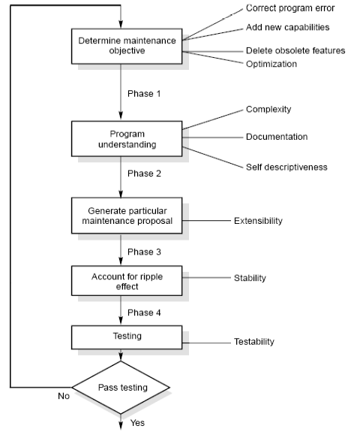
The software maintenance process
Maintenance Process
Program Understanding
The first phase consists of analyzing the program in order to understand.
Generating Particular Maintenance Proposal
The second phase consists of generating a particular maintenance proposal to accomplish the implementation of the maintenance objective.
Ripple Effect
The third phase consists of accounting for all of the ripple effect as a consequence of program modifications.

Slide 143
Maintenance Process
Modified Program Testing
The fourth phase consists of testing the modified program to ensure that the modified program has at least the same reliability level as before.
Maintainability
Each of these four phases and their associated software quality attributes are critical to the maintenance process. All of these factors must be combined to form maintainability.

Slide 144
Cost of maintenance (CO5)
Estimation of maintenance costs
Phase | Ratio
Analysis | 1
Design | 10
Implementation | 100
Defect repair ratio

Slide 145
Cost of maintenance
Belady and Lehman Model
M = P + Ke ^{(c-d)}
where
M : Total effort expended
P : Productive effort that involves analysis, design, coding, testing and evaluation.
K : An empirically determined constant.
c : Complexity measure due to lack of good design and documentation.
d : Degree to which maintenance team is familiar with the software.

Slide 146
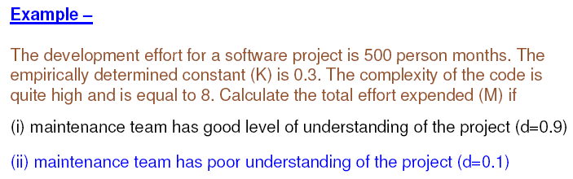
Example

Slide 147
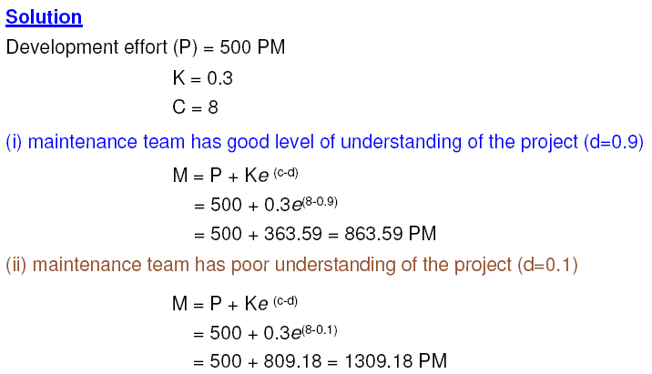
Example

Slide 148
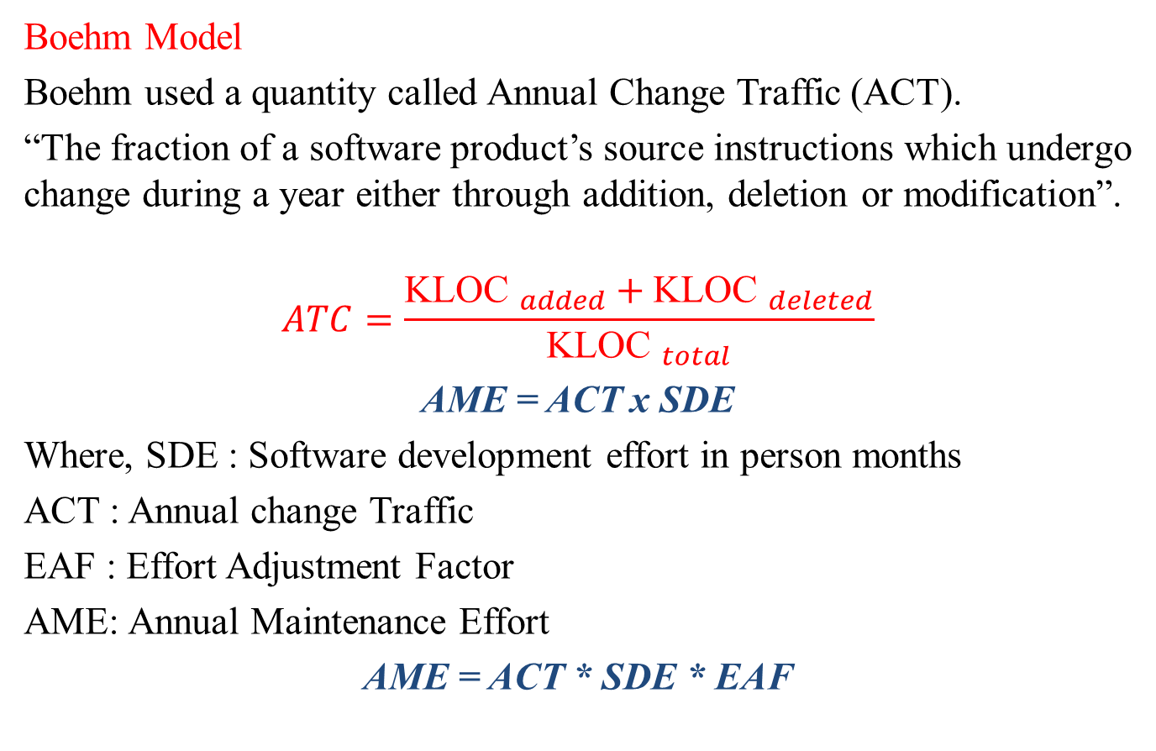
Cost of Maintenance
Boehm Model
Boehm used a quantity called Annual Change Traffic (ACT).
“The fraction of a software product’s source instructions which undergo change during a year either through addition, deletion or modification”.
$$ATC=\frac{{\text{KLOC} }_{added}+{\text{KLOC} }_{deleted}}{{\text{KLOC} }_{total}}$$
AME = ACT x SDE
Where, SDE : Software development effort in person months
ACT : Annual change Traffic
EAF : Effort Adjustment Factor
AME: Annual Maintenance Effort
AME = ACT * SDE * EAF

Slide 149
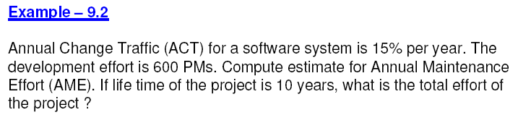
Example

Slide 150
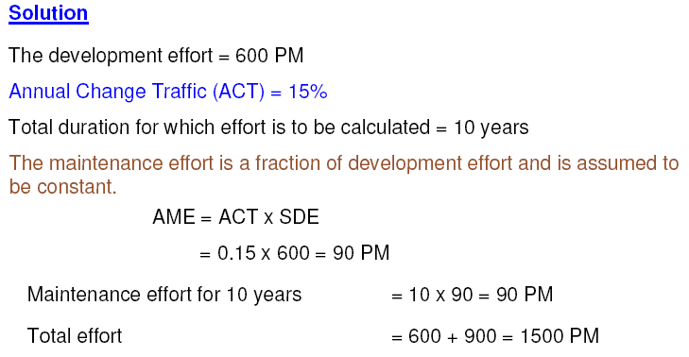
Example

Slide 151
Need of Maintenance (CO5)
Maintenance is needed for:-
Correct errors.
Change in user requirement with time.
Changing hardware/software environment.
To improve system efficiency
To optimize the code to run faster
To modify the components
To eliminate any unwanted side effects.
Thus, the maintenance is needed to ensure that the system continues to satisfy user requirements.

Slide 152
Daily Quiz
____ are the useful estimators for language-independent, early life cycle estimates.
Universal language points (ULP)
Universal functions points (UFP)
Function points (FP)
All of the above
What is forward engineering?
Forward engineering is the automation of one engineering artifact from another
Forward engineering is the term used to describe the key capability of environments that supports iterative environment
Round trip engineering is a type of engineering which forwards the process of production
None of the above
What is reverse engineering?
Reverse engineering is the automation of one engineering artifact from another
Reverse engineering is the term used to describe the key capability of environments that supports iterative environment
Reverse engineering is a type of engineering which reverse the process of production
Reverse engineering is the generation or modification of a more abstract representation from an existing artifact

Slide 153
Daily Quiz
A COCOMO model is
(a) Common Cost estimation model (b) Constructive cost Estimation model
(c) Complete cost estimation model (d) Comprehensive Cost estimation model
5. Estimation of software development effort for organic software is COCOMO is
(a) E=2.4(KLOC)1.05PM (b) E=3.4(KLOC)1.06PM
(c) E=2.0(KLOC)1.05PM (d) E-2.4(KLOC)1.07PM
6. Estimation of size for a project is dependent on
(a) Cost (b) Schedule (c) Time (d) None of the above
7. CASE Tool is
(a) Computer Aided Software Engineering (b) Component Aided Software Engineering
(c) Constructive Aided Software Engineering (d)Computer Analysis Software Engineering
8. The process by which existing processes and methods are replaced by new techniques is:
(a) Reverse engineering (b) Business process re-engineering
(c) Software configuration management (d) Technical feasibility

Slide 154
Daily Quiz
9. Adaptive maintenance is related to
(a) Modification in software due to failure
(b) Modification in software due to demand of new functionalities
(c) Modification in software due to increase in complexity
(d) Modification in software to match changes in the ever-changing environment.
10. Perfective maintenance refers to enhancements
(a) Making the product better
(b) Making the product faster and smaller
(c) Making the product with new functionalities
(d) All of the above
11. As per distribution of maintenance effort, which type of maintenance has consumed maximum share?
(a) Adaptive (b) Corrective (c) Perfective (d) Preventive

Slide 155
Daily Quiz
12. Legacy systems are
(a) old systems (b) new systems
(c) undeveloped systems (d) None of the above
13. The process of transforming a model into source code is
(a) Reverse Engineering (b) Forward engineering
(c) Re-engineering (d) Restructuring
14. Which is related to the need for preventive maintenance? a. Off-time production b. Increased automation c. Reduce machine breakdowns d. Increased machine breakdown 15. The __________ is not an approach to software cost estimation? A. Analytical B. Critical C. Empirical E. Heuristic

Slide 156
Weekly Assignment
What is software maintenance? Describe various categories of maintenance. Which category consumes maximum effort and why?
What are the implication of maintenance for a one person software production organization?
Some people feel that “maintenance is manageable”. What is your opinion about this issue?
Discuss various problems during maintenance. Describe some solutions to these problems.
Why do you think that the mistake is frequently made of considering software maintenance inferior to software development?
Explain the importance of maintenance. Which category consumes maximum effort and why?
Explain the steps of software maintenance with help of a diagram.
What is self descriptiveness of a program? Explain the effect of this parameter on maintenance activities.
Discuss the concept of re-engineering and its importance.

Slide 157
Faculty Video Links, Youtube & NPTEL Video Links and Online Courses Details
Youtube/other Video Links
https://www.youtube.com/watch?v=PXYqu-OcBoY
https://www.youtube.com/watch?v=KqDlDubS-OU&list=PL8751DA481F0F0D17&index=21
NPTEL
https://nptel.ac.in/courses/106/105/106105182/
https://www.youtube.com/watch?v=RQNZWCl6eXI&list=PLBd76GK9sWTwVXm9FlVHOTXXbGY2vZR8z&index=1

Slide 158
MCQ
1 COCOMO was developed initially by
(a) B.W.Bohem
(c) B.Beizer
2 A COCOMO model is
Common Cost estimation model
Constructive cost Estimation model
Complete cost estimation model
(b) Gregg Rothermal
(d) Rajiv Gupta
(d) Comprehensive Cost estimation model
3 Estimation of software development effort for organic software is COCOMO is
(a) E=2.4(KLOC)^{1.05}PM
(c) E=2.0(KLOC)^{1.05}PM
(b) E=3.4(KLOC)^{1.06}PM
(d) E-2.4(KLOC)^{1.07}PM
4 Estimation of size for a project is dependent on
(a) Cost
(c) Time
(b) Schedule
(d) None of the above
5 In function point analysis, number of Complexity adjustment factor are
(a) 10
(c) 14
(b) 20
(d) 12

Slide 159
MCQ
6 Process of generating analysis and design documents is called
(a) Inverse Engineering
(c) Reverse Engineering
7. Regression testing is primarily related to
Functional testing
(c) Development testing
(b) Software Engineering
(d) Re-engineering
(b) Data flow testing
(d) Maintenance testing
8 Which one is not a category of maintenance ?
(a) Corrective maintenance
(c) Adaptive maintenance
(b) Effective maintenance
(d) Perfective maintenance
9 The maintenance initiated by defects in the software is called
(a) Corrective maintenance
(c) Perfective maintenance
10 Patch is known as
(a) Emergency fixes
(c) Critical fixes
(b) Adaptive maintenance
(d) Preventive maintenance
(b) Routine fixes
(d) None of the above

Slide 160
Glossary Questions
A product development approach where design and development are carried out at the same time. It is used to shorten the development life cycle and to release products more quickly. The simultaneous execution of design and development can help to improve design practicality. The critical path methood is used to estimate the shortest length of time needed to complete a project and to determine the amount of float for activities that are not part of the critical path. he amount of labor needed to complete a task. It is measured in person-hours or similar units. A Gantt chart is a type of bar chart that shows all the tasks constituting a project. Tasks are listed vertically, with the horizontal axis marking time. The lengths of task bars are to scale with tasks’ durations. A set of quality-management guidelines for projects. It is a standard created by the International Organization for Standardization. | Concurrent engineering Critical Path Method Effort Gantt chart ISO 10006

Slide 161
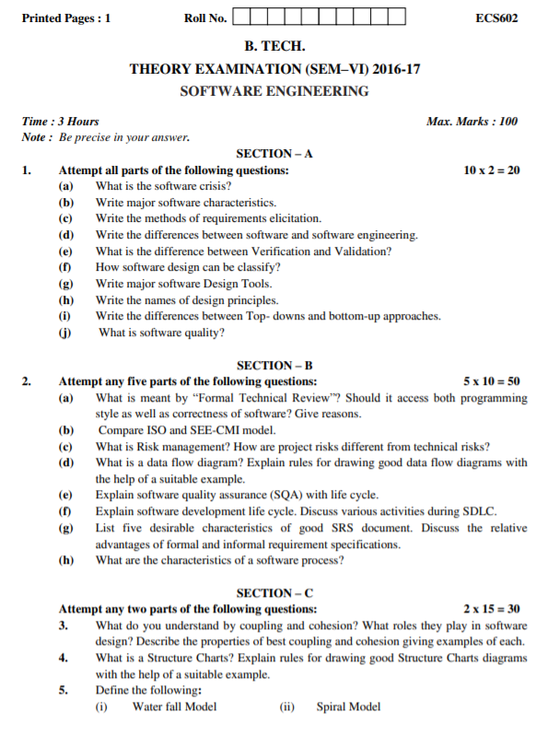
Old Question Papers

Slide 162
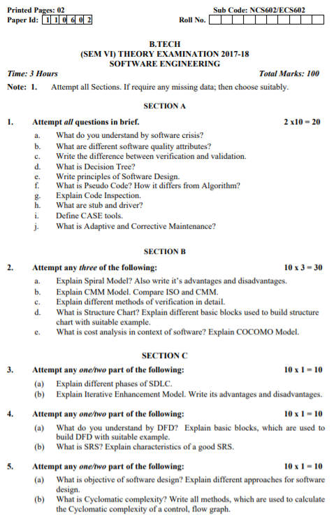
Old Question Papers

Slide 163
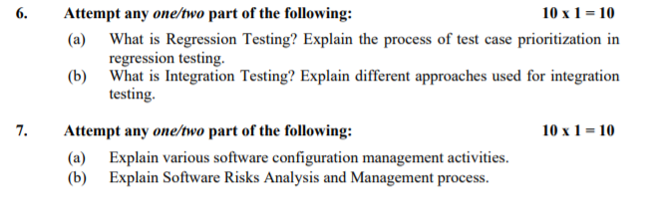
Old Question Papers

Slide 164
Expected Questions for University Exam
Discuss various problems during maintenance. Describe some solutions.
What is ripple effect? Discuss the various aspects of ripple effect and how does it affect the stability of a program?
What is reverse engineering? Discuss levels of reverse engineering
compare reverse engineering and re-engineering.
What are configuration management activities? Draw the Performa of change request form

Slide 165
Recap of Unit
Software as an Evolutionary Entity, Need for maintenance,
Categories of Maintenance: Preventive, Corrective and Perfective Maintenance,
Cost of Maintenance, Software ReEngineering, Reverse Engineering.
Software Configuration Management Activities, Change Control Process,
Software Version Control, An Overview of CASE Tools.
Estimation of Various Parameters such as Cost, Efforts, Schedule/Duration
Constructive Cost Models (COCOMO), Resource allocation Models,
Software Risk Analysis and Management.

Slide 166
References
R. S. Pressman, Software Engineering: A Practitioners Approach, McGraw Hill.
Rajib Mall, Fundamentals of Software Engineering, PHI Publication.
K. K. Aggarwal and Yogesh Singh, Software Engineering, New Age International Publishers.
Pankaj Jalote, Software Engineering, Wiley
Deepak Jain,” Software Engineering: Principles and Practices”, Oxford University Press.
Munesh C. Trivedi, Software Engineering, Khanna Publishing House
N.S. Gill, Software Engineering, Khanna Publishing House

Slide 167
Noida Institute of Engineering and Technology, Greater Noida
Thank You

